Slide 1
Charts used for Exploratory Analysis

Slide 2
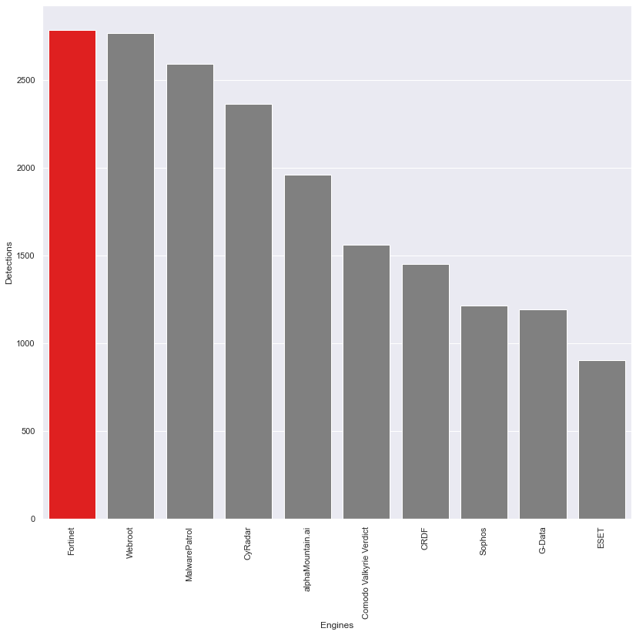
The bar graph highlights the Engine with
the highest number of detections, Fortinet

Slide 3
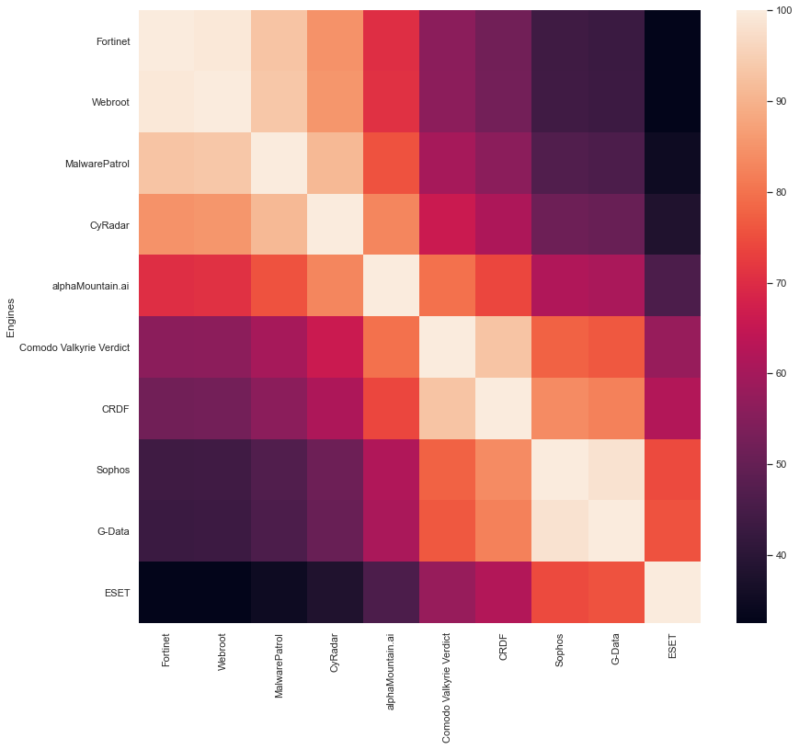
This heatmap shows the similarities between
each of the engines in terms of detections

Slide 4
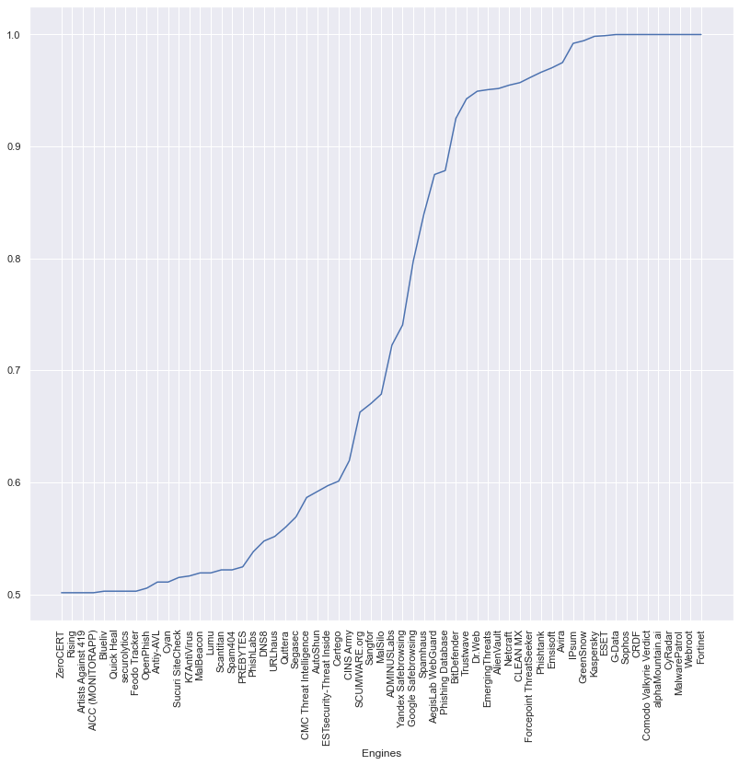
This cumulative frequency curve shows the
contribution of each engine to the total detections

